Slide 1
4 Collections
PicVerse
users · posts · comments · likes
3 Aggregations
most liked · active users · engagement
Social Media Mini Platform
MongoDB · Flask (Python) · HTML / CSS / JS
Full CRUD
Project Idea 5 | Group 9
create · read · update · delete

Slide 2
Tech Stack
🍃
🐍
🎨
🔐
MongoDB
Flask + PyMongo
HTML / CSS / JS
bcrypt
Local Community Edition
Document store, 4 collections
Python backend
REST API via Blueprints
Vanilla frontend
Single page, no frameworks
Password hashing
Salt + hash, never plaintext
All services run locally — no cloud required

Slide 3
Schema Design
REFERENCED DESIGN
users
posts
comments
likes
_id
_id
_id
_id
username (unique)
user_id → users
post_id → posts
post_id → posts
email (unique)
caption
user_id → users
user_id → users
bio
image_url
text
created_at
password (hashed)
created_at
created_at
→ References used throughout — prevents embedding unbounded arrays (comments/likes)

Slide 4
Indexing
5 INDEXES TOTAL
users
username
UNIQUE
Prevent duplicate usernames, fast login lookup
users
email
UNIQUE
Prevent duplicate emails
posts
user_id
ASCENDING
Required by spec — fast user feed queries
comments
post_id + user_id
ASCENDING
Fast comment fetch per post
likes
post_id + user_id
COMPOUND UNIQUE
Prevents duplicate likes from same user

Slide 5
CRUD Operations
4 ROUTE FILES
users.py
posts.py
comments.py
likes.py
POST /api/users/ → Register
POST /api/posts/ → Create post
POST /api/comments/ → Add comment
POST /api/likes/ → Like post
POST /api/users/login → Authenticate
GET /api/posts/ → Feed (sorted)
GET /api/comments/post/<id> → By post
DELETE /api/likes/ → Unlike
GET /api/users/ → List all
GET /api/posts/<id> → Single post
DELETE /api/comments/<id> → Remove
GET /api/likes/count/<id> → Count
PUT /api/users/<id> → Update
PUT /api/posts/<id> → Edit
DELETE /api/users/<id> → Remove
DELETE /api/posts/<id> → Remove

Slide 6
Aggregation Pipelines
routes/analytics.py
🔥 Most Liked Posts
⚡ Most Active Users
📊 Engagement per Post
/api/analytics/most-liked
/api/analytics/active-users
/api/analytics/engagement
$group + $sum
$group + $sum
$group on likes
$sort
$sort
$group on comments
$limit (top 5)
$limit (top 5)
Merge in Python
$lookup (join posts)
$lookup (join users)
Union of post_ids
$unwind
$unwind
$project
$project

Slide 7
Frontend UI
SINGLE PAGE APP
🔐
Login / Register
📰
Feed
❤️
Post Modal
Toggle between sign in and register. Auto-login after account creation.
Post cards grid. Click any card to open full post modal.
Like/unlike toggle. Live comment section. Image display.
✏️
New Post
👤
Users
📊
Analytics
Caption input. URL or local file upload toggle for image.
Create new users. View all registered accounts.
Most liked posts, active users, engagement per post.

Slide 8
Authentication Flow
bcrypt + localStorage
1
2
3
4
5
6
Register
Hash
Store
Login
Session
Auto-use
User submits username,
email, password
bcrypt hashes password
with auto-generated salt
User doc saved to
MongoDB users collection
bcrypt.checkpw() verifies
password on sign in
id + username stored
in localStorage
All API calls read
session automatically
→
→
→
→
→
Password is NEVER stored in plaintext. Session ID auto-fills all post/like/comment actions.

Slide 9
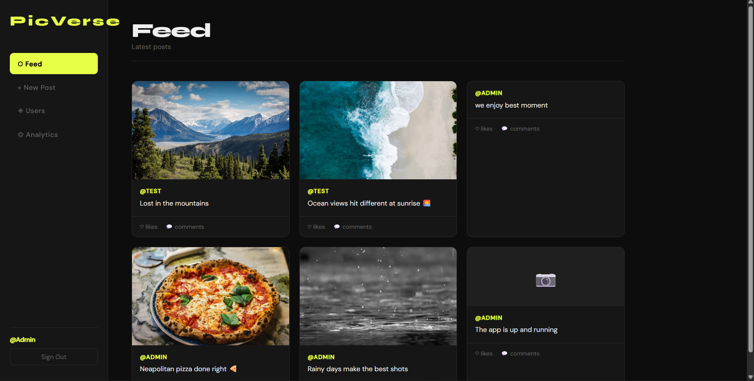
LIVE APP VIEW

Slide 10
Thank You
By
Indranil Roy(CSF 007)
Rajdeep Sarkar(CSF 008)
Saikat Pal(CSF 009)
Somnath Bera(CSF 010)

